Slide 1
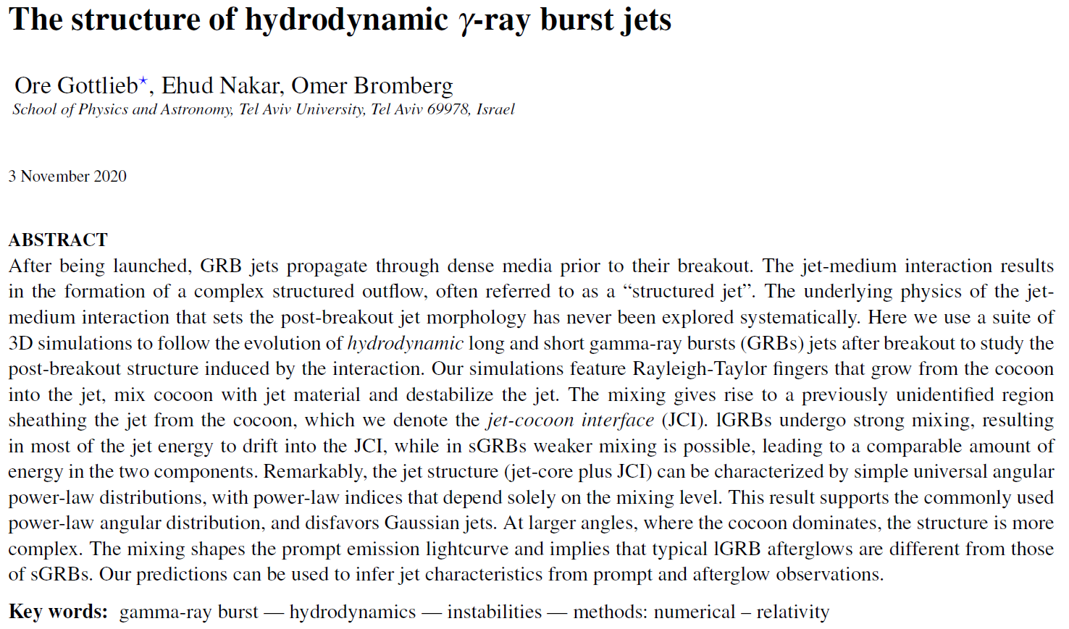
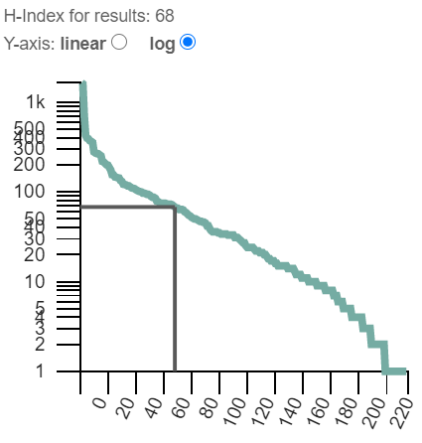
High-energy Journal Club
Clément Pellouin – 14/12/2020

Slide 2
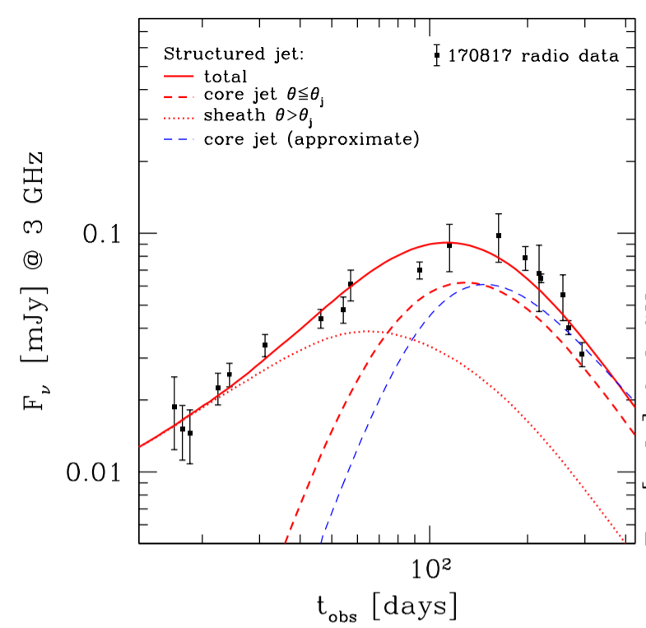
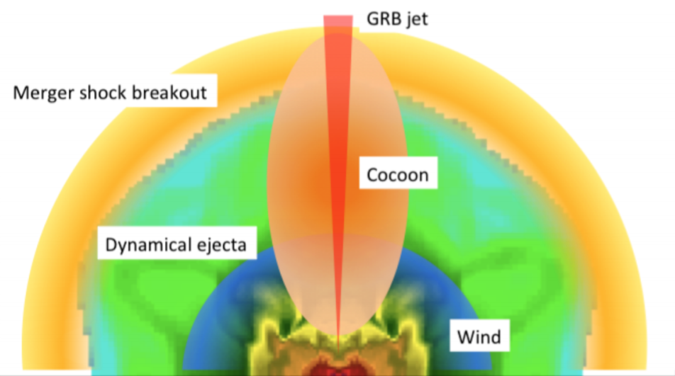
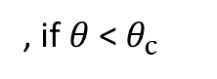
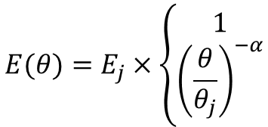
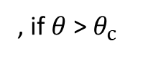
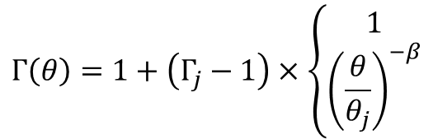
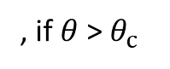
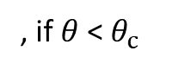
I- Introduction
Prompt energetics → collimated jet
2 populations of GRBs : lGRBs & sGRBs
GW 170817 radio afterglow (Duque+19)
Lateral structure :
$$E(θ)=E_{j}×\left\{\begin{aligned}1 \\ {\left(\frac{θ}{θ_{j}}\right)}^{−α}\end{aligned}\right.$$
, if $θ$ < $θ_{c}$
, if $θ$ > $θ_{c}$
Unified structure of GRB formation (Teboul & Piran+17)
, if $θ$ < $θ_{c}$
$$Γ\left(θ\right)=1+\left(Γ_{j}−1\right)×\left\{\begin{aligned}1 \\ {\left(\frac{θ}{θ_{j}}\right)}^{−β}\end{aligned}\right.$$
, if $θ$ > $θ_{c}$

Slide 3
I- Introduction
2 sites control jet structure :
Launching site (initial acceleration and collimation)
Interaction with surrounding medium during propagation
3D hydrodynamical simulations :
Turbulent mixing → symmetry breaking → Lateral energy dissipation
Results:
Direct correlation mixing/lateral structure
Post-breakout structure with 3 components (jet, JCI, cocoon)

Slide 4
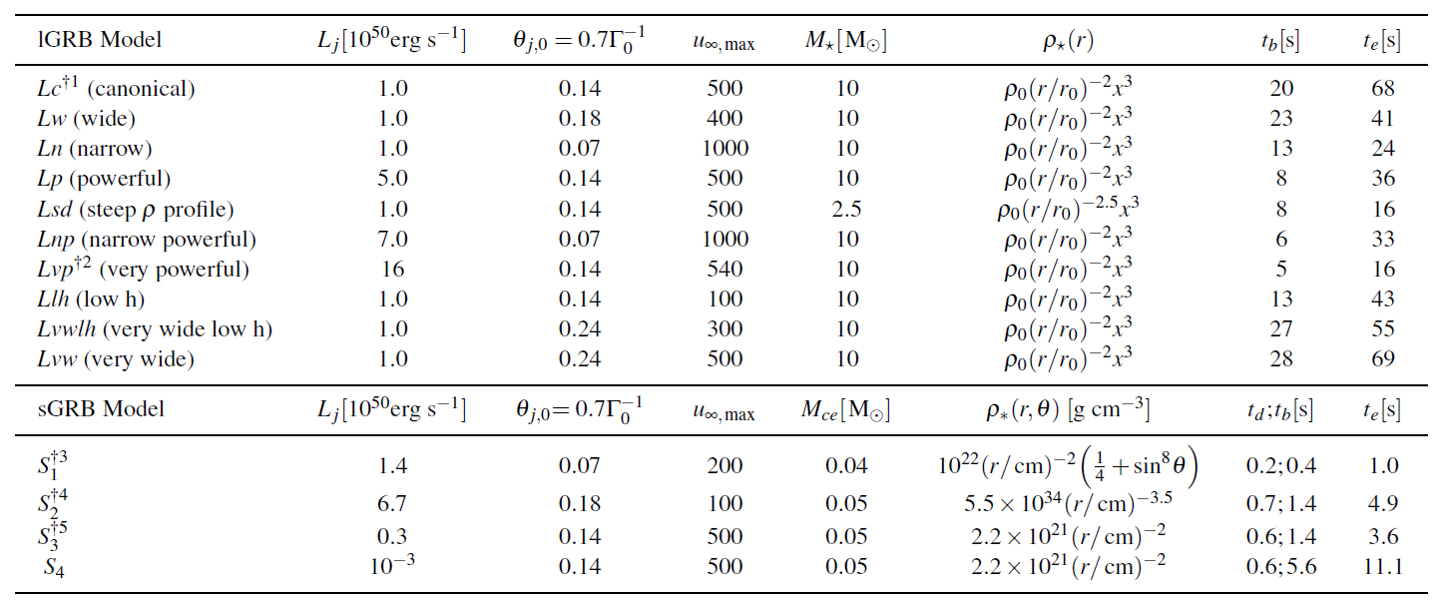
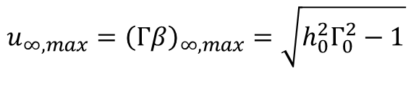
II- Models
$$u_{∞,max}={\left(Γβ\right)}_{∞,max}=\sqrt{h_{0}^{2}Γ_{0}^{2}−1}$$
t_{d} : Delay time
t_{b} : Breakout time
t_{e} : Ejection time

Slide 5
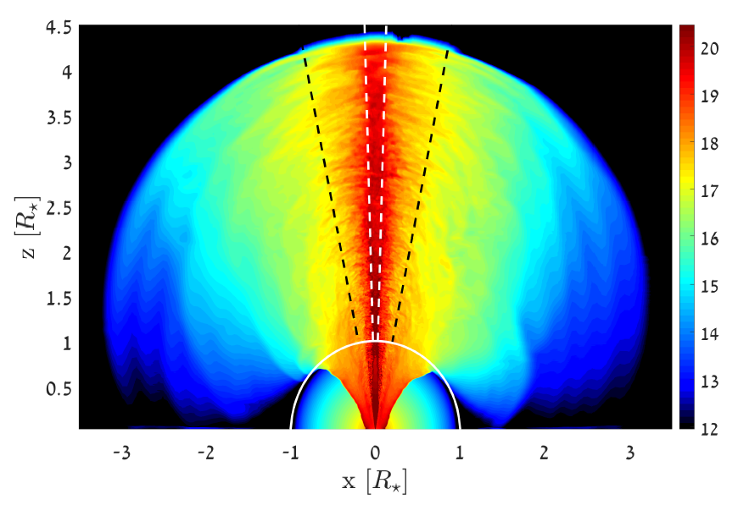
III- Jet structure inside a dense medium : evolution & mixing
4 regions :
Jet
Jet head
Inner cocoon
Outer cocoon

Slide 6
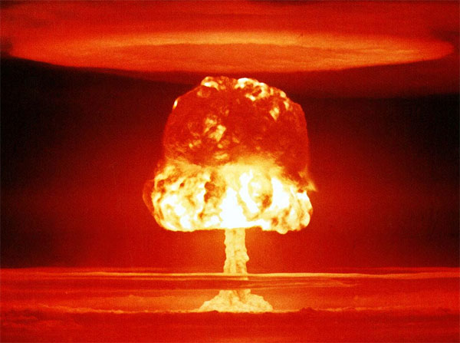
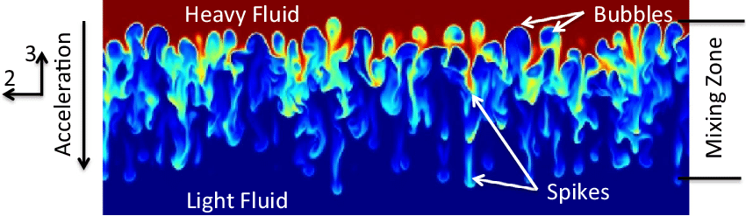
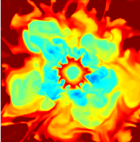
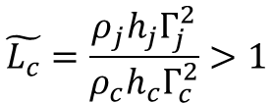
III- Jet structure inside a dense medium : evolution & mixing
Rayleigh-Taylor instability :
Schwarzkopf+15
Nuclear mushroom
Instability growth if
$$\tilde{L_{c}}=\frac{ρ_{j}h_{j}Γ_{j}^{2}}{ρ_{c}h_{c}Γ_{c}^{2}}>1$$
2D cut of the jet

Slide 7
III- Jet structure inside a dense medium : evolution & mixing
Rayleigh-Taylor instability :
Schwarzkopf+15
Nuclear mushroom
Richmeyer-Meshkov instability accelerates fingers growth
2D cut of the jet
Relativistic Kevin-Helmoltz instability too slow

Slide 8
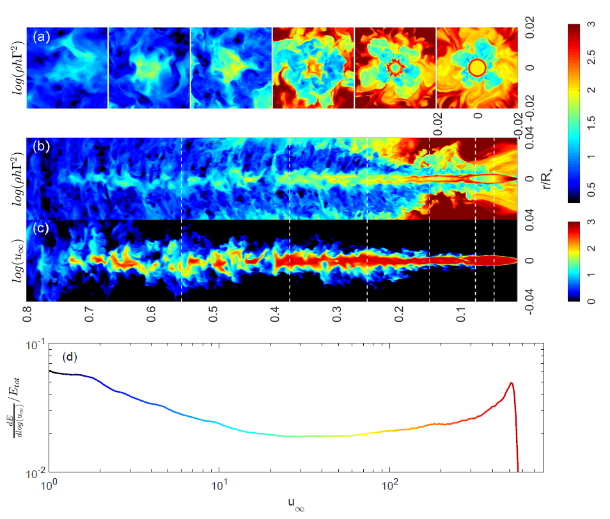
III- Jet structure inside a dense medium : evolution & mixing
Enthalpy density
Terminal proper velocity
(no further mixing)
Total energy distribution (excluding rest mass)

Slide 9
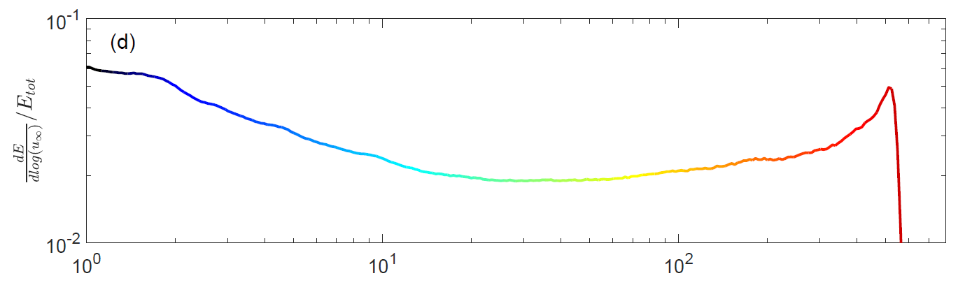
III- Jet structure inside a dense medium : evolution & mixing
Intense mixing → flatter energy distribution
More mixing ?
Larger jet opening angle
Higher jet specific enthalpy
Lower jet luminosity
Higher medium density
sGRBs have stabler jets

Slide 10
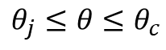
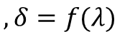
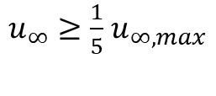
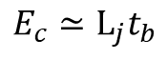
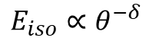
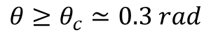
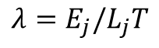
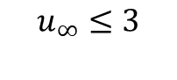
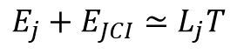
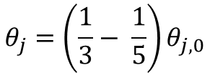
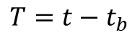
IV- The post-breakout structure
3 regions :
Core
Cocoon
Jet-Cocoon Interface (JCI)
ultra-relativistic:
narrow core angle:
$u_{∞}≥\frac{1}{5}$ $u_{∞,max}$
$$θ_{j}=\left(\frac{1}{3}− \frac{1}{5}\right)θ_{j,0}$$
newtonian:
large angles:
Energy:
$$u_{∞}≤3$$
$$θ≥θ_{c}≃0.3 rad$$
$E_{c}≃L_{j}t_{b}$
$$T=t−t_{b}$$
mildly relativistic
intermediate angles:
$$E_{j}+E_{JCI}≃L_{j}T$$
$$λ=E_{j}/L_{j}T$$
: mixing parameter
$$θ_{j}≤θ≤θ_{c}$$
In the JCI,
$$E_{iso}∝θ^{−δ}$$
$$, δ=f(λ)$$

Slide 11
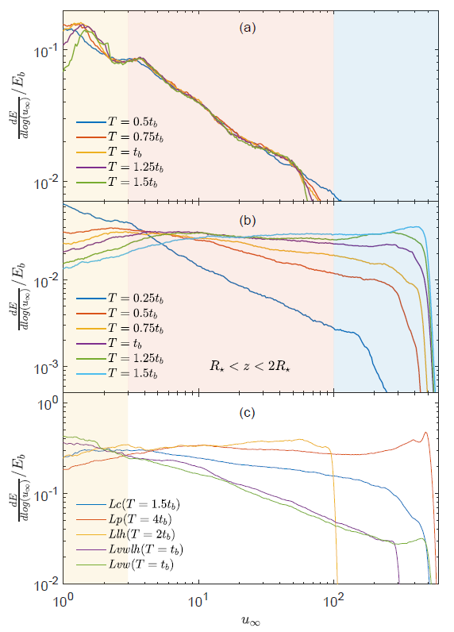
IV- The post-breakout structure (lGRBs)
Energy distribution of the first slice of matter that breaks out, at various times
Energy distribution of matter between R⬆ and 2 R⬆ at various times
Overall energy distribution when the jet head reaches 10 R⬆, for different models

Slide 12
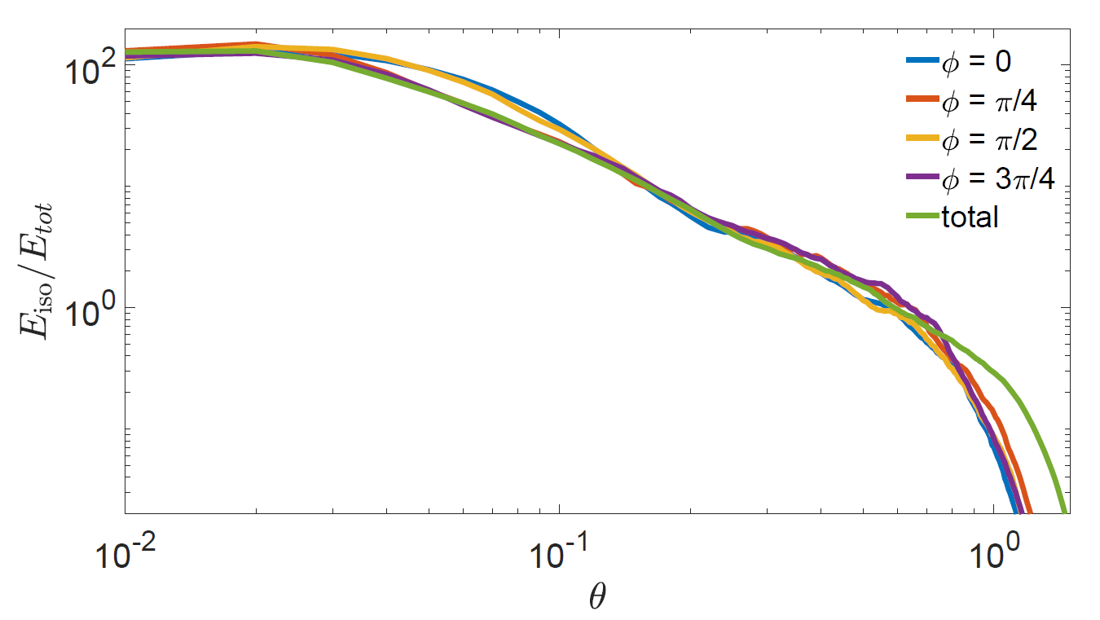
IV- The post-breakout structure (lGRBs)
Is the post-breakout structure strongly asymmetric ?
Energy distribution, sliced at different angles φ

Slide 13
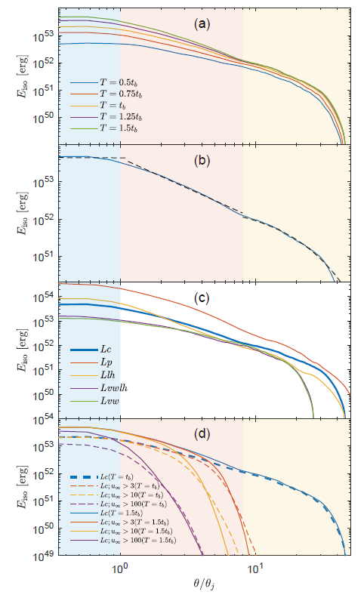
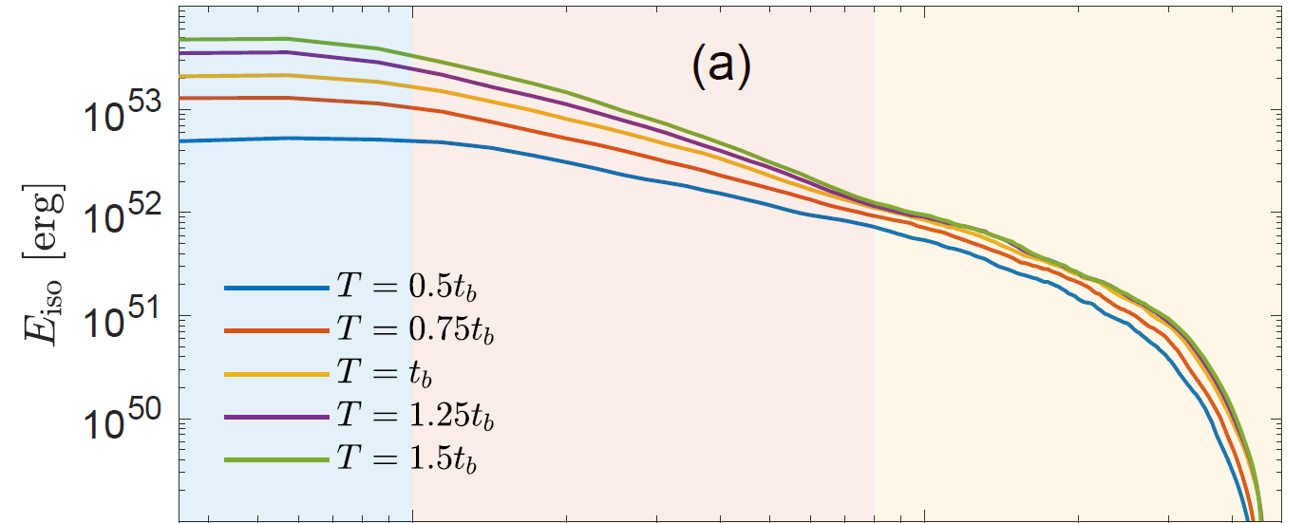
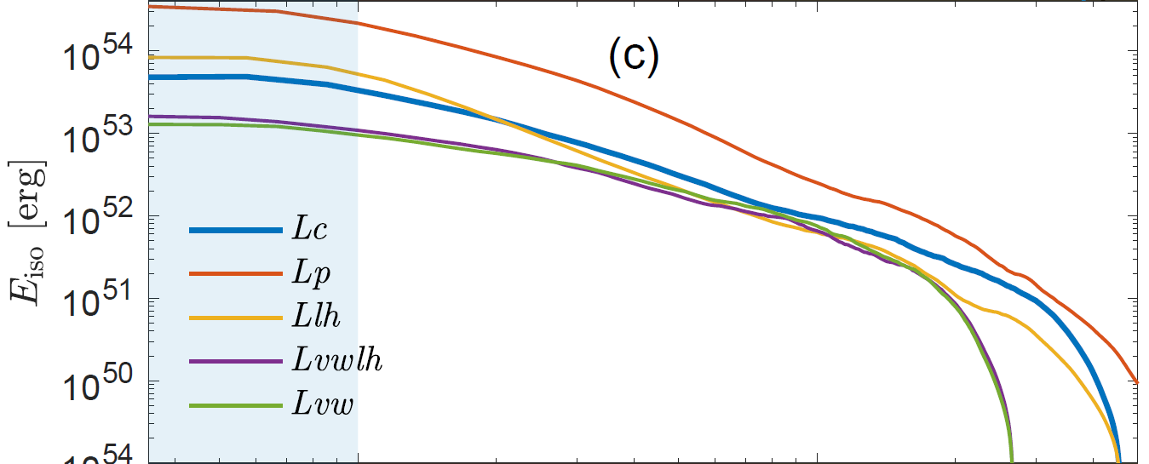
IV- The post-breakout structure (lGRBs)
Angular energy distribution at various times
Angular energy distribution, different models

Slide 14
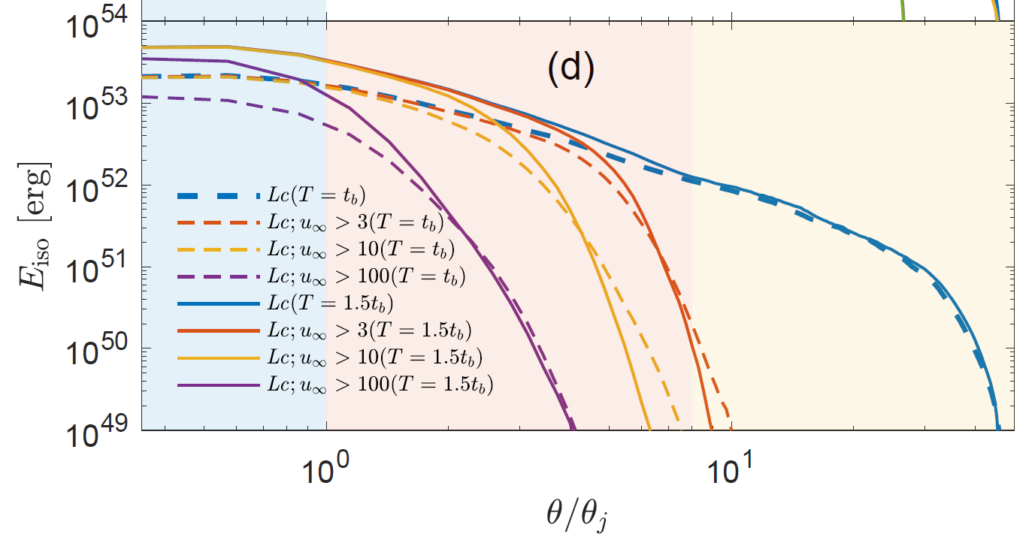
IV- The post-breakout structure (lGRBs)
Angular energy distribution at various times

Slide 15
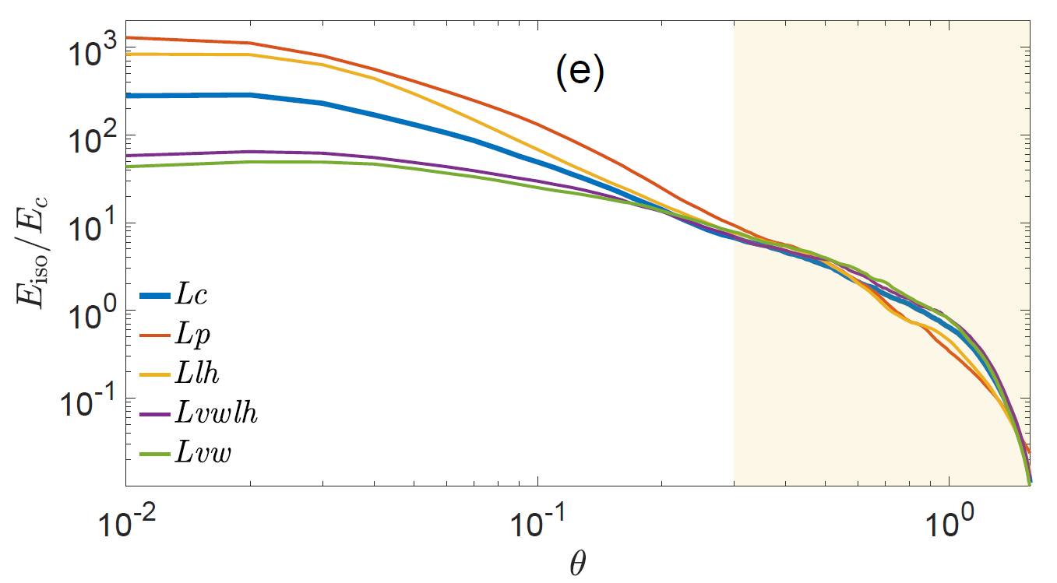
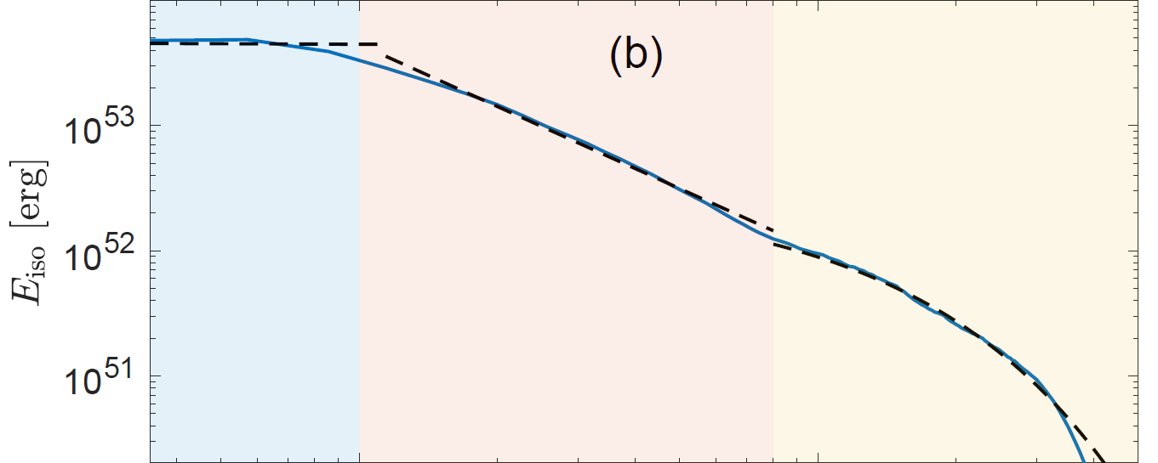
IV- The post-breakout structure (lGRBs)
The cocoon starts at the same angle for all models
Fit at a given time, with 3 distinct components

Slide 16
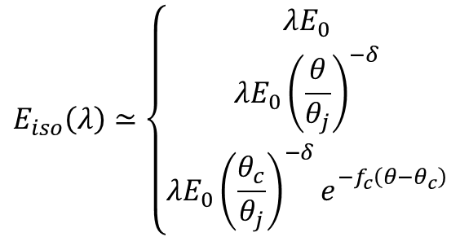
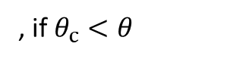
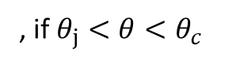
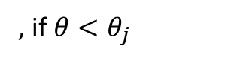
IV- The post-breakout structure (lGRBs)
$$E_{iso}\left(λ\right)≃\left\{\begin{aligned}λE_{0} \\ λE_{0}{\left(\frac{θ}{θ_{j}}\right)}^{−δ} \\ λE_{0}{\left(\frac{θ_{c}}{θ_{j}}\right)}^{−δ}e_{}^{−f_{c}\left(θ−θ_{c}\right)}\end{aligned}\right.$$
, if $θ<θ_{j}$
, if $θ_{j}<θ<θ_{c}$
, if $θ_{c}<θ$
Fit at a given time, with 3 distinct components

Slide 17
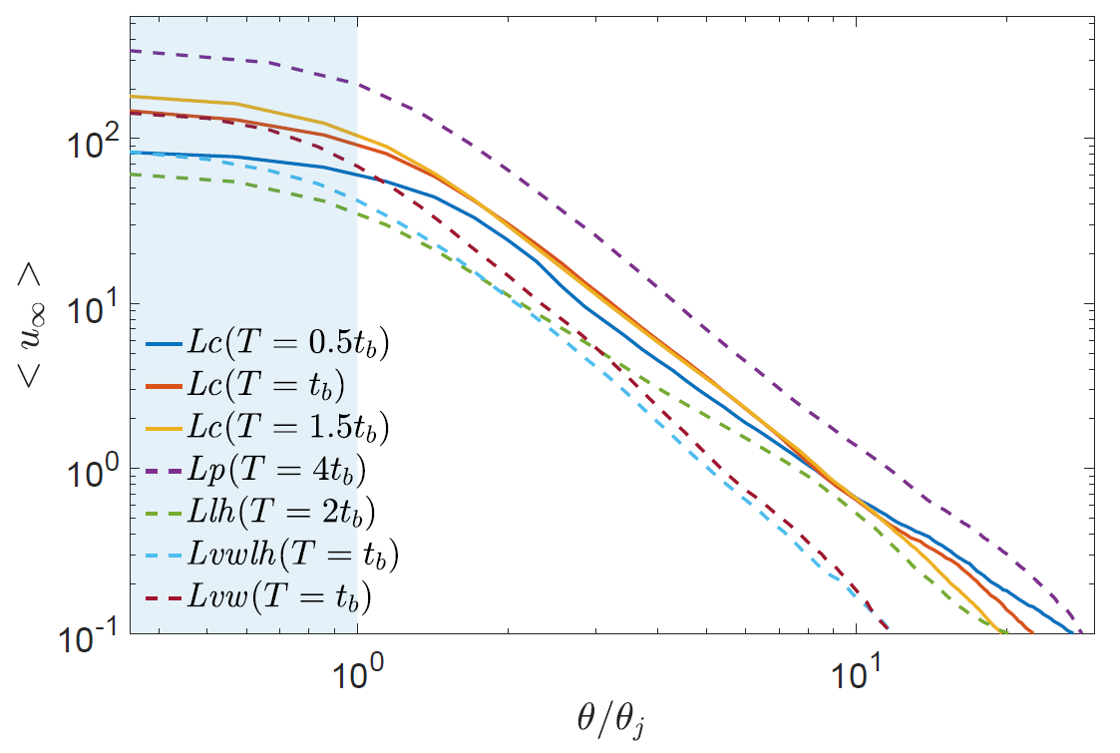
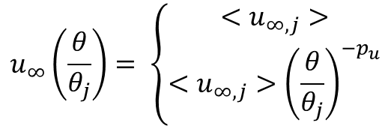
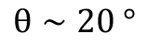
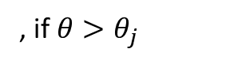
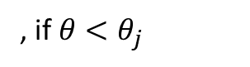
IV- The post-breakout structure (lGRBs)
$$u_{∞}\left(\frac{θ}{θ_{j}}\right)= \left\{\begin{aligned}<u_{∞,j}> \\ <u_{∞,j}>{\left(\frac{θ}{θ_{j}}\right)}^{−p_{u}}\end{aligned}\right.$$
, if $θ<θ_{j}$
, if $θ>θ_{j}$
Pure angular structure until
$$θ∼20 °$$

Slide 18
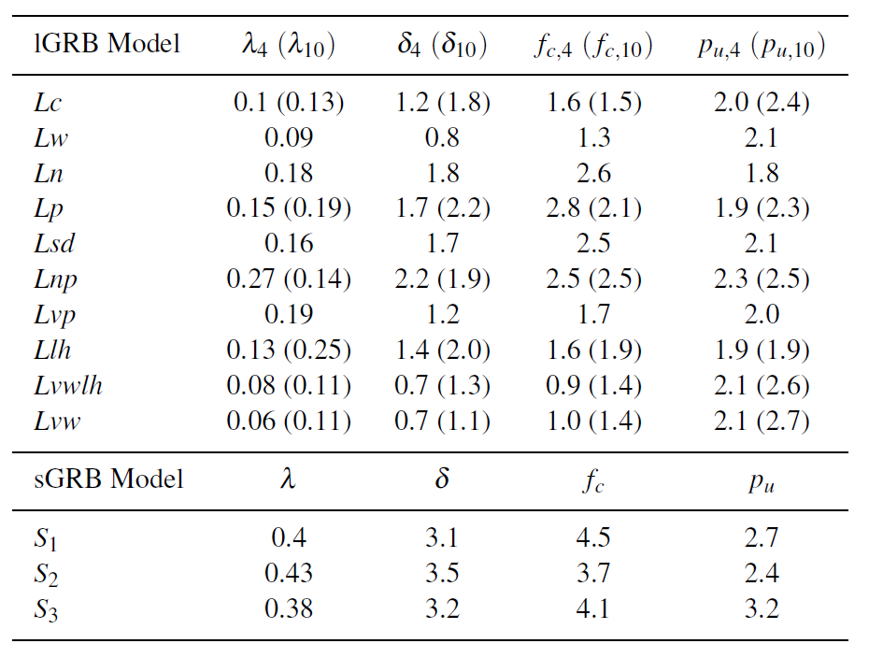
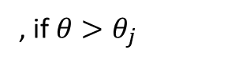
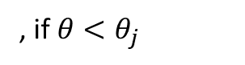





IV- The post-breakout structure (lGRBs)
$$E_{iso}\left(λ\right)≃\left\{\begin{aligned}λE_{0} \\ λE_{0}{\left(\frac{θ}{θ_{j}}\right)}^{−δ} \\ λE_{0}{\left(\frac{θ_{c}}{θ_{j}}\right)}^{−δ}e_{}^{−f_{c}\left(θ−θ_{c}\right)}\end{aligned}\right.$$
, if $θ<θ_{j}$
At later times, mixing drops:
more energy in the core jet (λ increases)
steeper energy decrease slope (δ increases)
Steeper velocity gradient (p_{u} increases)
, if $θ_{j}<θ<θ_{c}$
, if $θ_{c}<θ$
$$u_{∞}\left(\frac{θ}{θ_{j}}\right)= \left\{\begin{aligned}<u_{∞,j}> \\ <u_{∞,j}>{\left(\frac{θ}{θ_{j}}\right)}^{−p_{u}}\end{aligned}\right.$$
, if $θ<θ_{j}$
, if $θ>θ_{j}$

Slide 19


IV- The post-breakout structure (sGRBs)
Similar as lGRBs with less dense surrounding medium → more collimated & stabler jets
higher λ, δ
cocoon extending to smaller angles
(b) Angular energy distribution, different models
(c) 3-segments fitting
Overall energy distribution when the jet head reaches 10 R⬆, for different models

Slide 20

IV- The post-breakout structure (sGRBs)
A model with lower luminosity :
→ Closer to lGRBs shapes

Slide 21
IV- The low-luminosity sGRBs problem
Breakout time is 10x too long !
Possible explanations:
Ejected mass may be too high
Ejecta might be highly anisotropic
With this we can produce sGRBs but might not account for r-process elements in the Universe…
Another explanation:
Weakly magnetized jet → fewer instabilities → faster propagation → more luminosity

Slide 22

IV- Gaussian or power-law angular profile ?
“As expected these distributions are incompatible with gaussian fits”

Slide 23

IV- 2D vs. 3D
2D hydrodynamic simulation
3D hydrodynamic simulation

Slide 24

V- Emission
Prompt :
light curves, spectra with temporal evolution
some jets may not live long enough to produce a GRB
higher mixing :
→ lower radiative efficiency
→ high temporal efficiency variability
→ alteration of off-axis emission
Afterglow :
long and short GRBs : different light curves
if mixing is weak (like in most sGRBs) :
→ if $θ_{obs}<θ_{j}$, afterglow similar to top-hat
→ if $θ_{obs}>θ_{j}$, afterglow peaks at late time, with a more complex rising phase (hump & peak, 2 peaks)
If mixing is high (most likely in lGRBs) :
→ if $θ_{obs}<θ_{j}$, early profile similar to top-hat, but decrease shallower
→ if $θ_{obs}>θ_{j}$, rise, peak, shallow decrease, fast decrease

Slide 25
VI- Summary
Rayleigh-Taylor instabilities between cocoon and jet pre-breakout → mixing
Mixing → Transition layer : JCI
In lGRBs, after T = t_{b}, uniform energy distribution for jet in the star
In sGRBs, less mixing → more energy in the core
Prior to breakout, almost all injected energy → cocoon
After breakout, cocoon energy constant, injection in core & JCI
lGRBs: more energy in the JCI of due to higher λ, larger JCI
GRB distribution of E_{iso} and velocity follow a power law after the core
2D simulations of limited accuracy
The presence of a magnetic field can stabilize the jet

